Slide 1

Step into python
Lection 1: What is a Python?

Slide 2

Agenda
1
What is python?
2
Why should I use python?
3
Where can I get python?
4
Where can I develop in python?
5
Wait, IT HAS package manager?
6
Conclusion

Slide 3

What is Python?
Automatic memory management
Full introspection
Dynamic typing
High-level
Data structures
Exception handling
Multi-thread computing

Slide 4
Why should I use Python? Opportunities
Python is a one of the easiest high-level languages, which can be expanded by various packages. Also, this language is easy to learn, so you can start developing own scripts/applications in short terms after start actual learning program!
Interpretable
Interactive
Object oriented
Ported
Expandable

Slide 5

Problems?
Speed. Python actually slow.
Memory. Python would like to take more RAM, than other languages.
Python scripts requires more testing.

Slide 6
Where can I get Python?
For Windows/Mac OS you can easily download Python from official website: https://www.python.org/
For Linux users you can download python from command-line environment:
For Debian/Ubuntu/Linux mint: sudo apt-get update && sudo apt-get install –y python3
For Fedora: sudo dnf –y update && sudo dnf install python3
For Arch Linux: sudo pacman –S python
For Gentoo: emerge --ask dev-lang/python3.10

Slide 7
Where can I develop in Python?

Slide 8

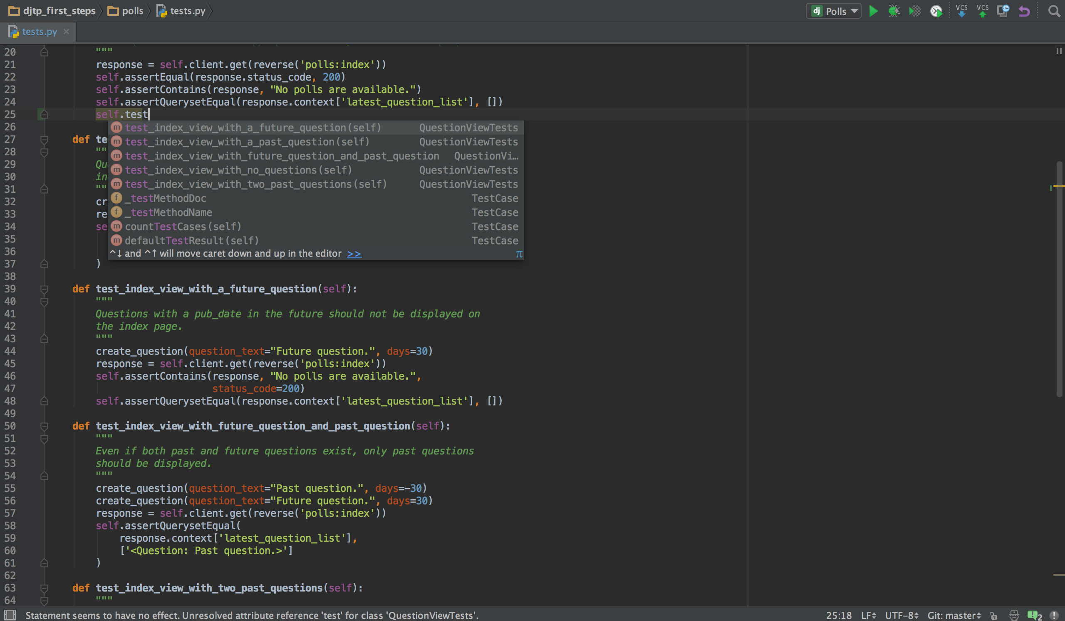
PyCharm
Easiest way to develop in Python – just download and use PyCharm IDE. It supports everything: virtual environments, pip packages installation, and project management. One of the best IDE’s for python usage, and can be downloaded from https://www.jetbrains.com/pycharm/.

Slide 9

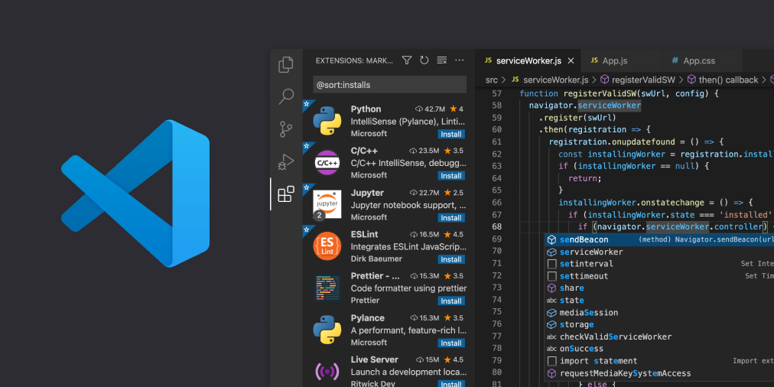
Visual Studio Code
Next stop – Visual studio code. Very lightweight IDE, suitable for many different languages. Especially, for Python it can be used with python extensions (https://code.visualstudio.com/docs/languages/python), IDE can be downloaded here: https://code.visualstudio.com/.

Slide 10


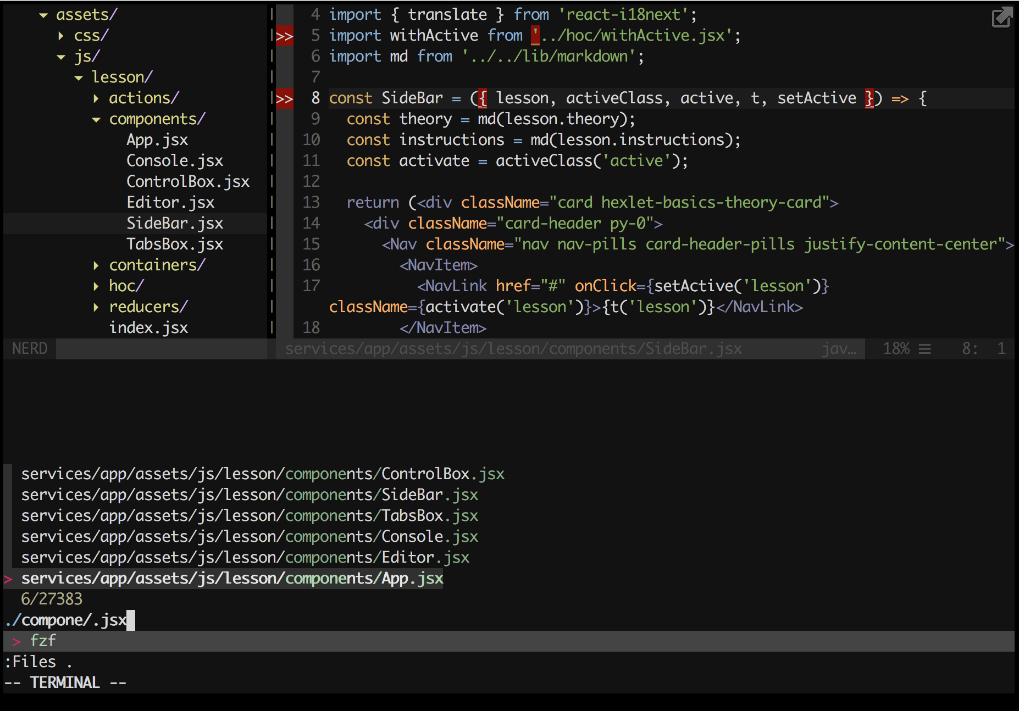
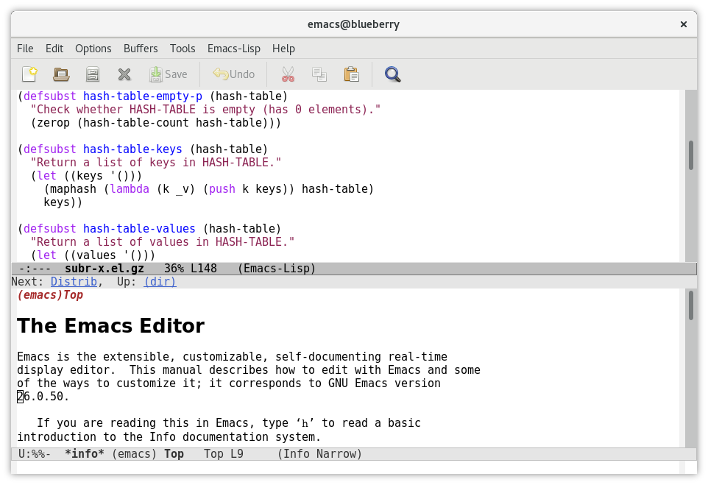
Vim/Emacs
For experienced developers, Vim or Emacs are great decision. If you already have your favorite IDE which was used for years – why would not use it for Python? These IDE are very flexible for many different tasks, starting from script development, and going far away for big projects with complicated logics.

Slide 11
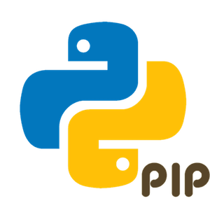
Package manager PIP
Therefore, python has its own package manager, that can be used for downloading and installation packages for scaling Python features.
If you’re using Linux – this package manager should be installed separately. To install it on Ubuntu – just use sudo apt-get -y install python3-pip command.
To install any python package, you can use pip3 install <package name> command.

Slide 12
Conclusion

Slide 13
Well…
Python – the best language to start with because of its easy-to-learn syntax and powerful features.
You can use your favorite editor to write python scripts, and it’s easy to install on many different platforms.
Using Python, you can easily solve many everyday problems just by automating them using high-level python scripts.
Also, because of high-level implementation and many different ports, python script written on Windows can be launched on Linux and Mac OS.

